Slide 1
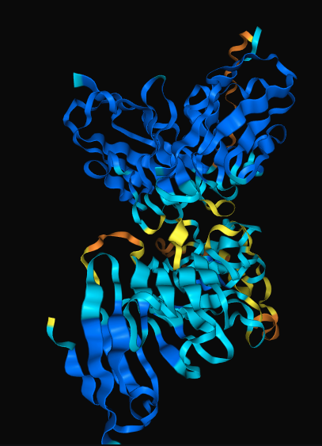
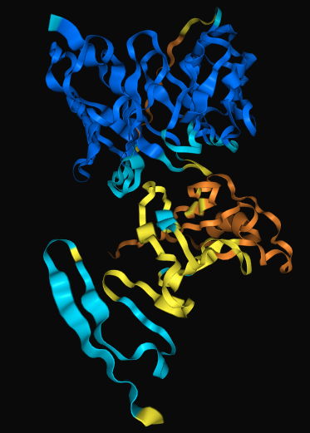
CD19 deltaexon2 isomer changes AlphaFold3 predicted antibody binding mode
CD19 Antibody:Antigen
CD19 deltaexon2 Antibody:Antigen

Slide 2
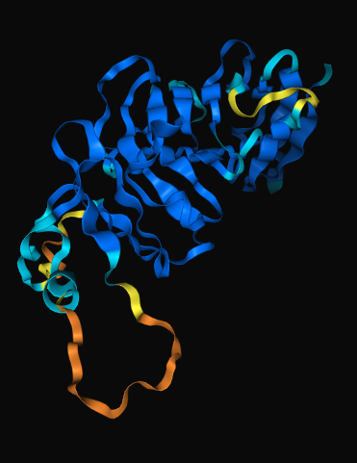
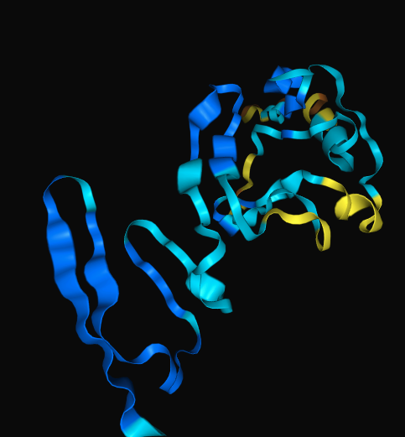


CD19 deltaexon2 isomer changes AlphaFold3 predicted antibody binding mode
CD19 Antibody:Antigen
CD19 deltaexon2 Antibody:Antigen

Slide 3
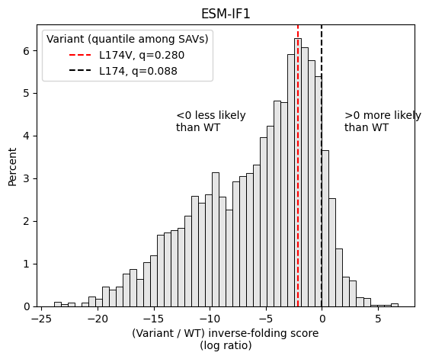
L174V variant is in top 28th percentile of ESM-IF1 single-amino acid variants
Input: AlphaFold3 predicted CD19 antigen only (from 7URV PDB)
Nb: 22nd percentile if using Antibody-Antigen predicted structure

